Slide 1
Sri Lanka China Business Co-operation Council

Slide 2
Key objectives
To promote encourage ,develop, foster & strengthen trade and commerce between sri lanka & peoples republic of china .
To assist ,encourage,& strengthen the economic co-operation between Sri Lanka & P.R.of china
To provide a forum where trade chambers & entrepreneurs of the two countries could discuss mutual problems affecting trade & commerce
To promote bilateral & multi lateral trade, business & commercial activities between Sri Lanka & China

Slide 3
Key milestones in our journey

Slide 4
Inaugurated on 6th June 1994
Inaugurated on 06th June 1994 under the auspicious of the Sri Lanka China Society.
Conducted a Seminar on “How to do Business with China”, in September.
Hosted a visiting delegation from the Guangdong Friendship Association.

Slide 5
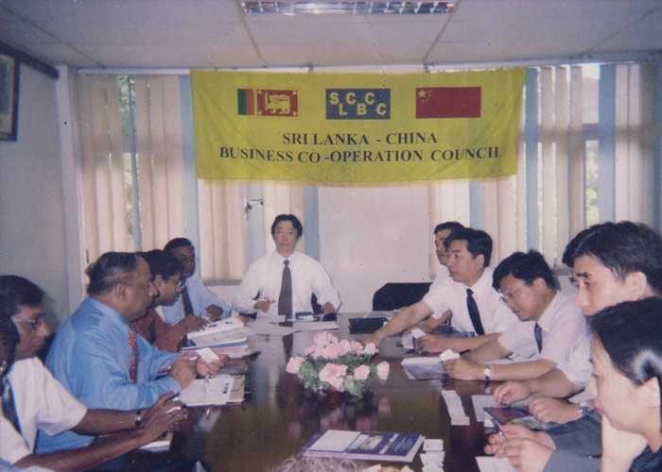
Joined the national chamber of commerce in 1995
Joined the National Chamber of Commerce of Sri Lanka as it’s first Business Council Member.
A delegation visited China, on an Invitation extended by the Guangdong People’s Association for Friendship with Foreign Countries.
2 MOU’s WHERE SIGNED with the Guangdong Association of Enterprise Management and CCPIT Guangdong Sub Council.

Slide 6
Delegation visited china on HR & technology transfer session -1999
A 5-member delegation visited China to discuss on Human Resource Development and Transfer Technology, and China agreed to train young technicians from Sri Lanka in Advanced technology.
---------
Organized a Public Lecture on “Trade Relations between Sri Lanka and China “to commemorate 50 years of Modern China.
--------
The first team of young Sri Lankan technicians were sent to China for an Advanced Technology Training Program on Porcelain manufacture

Slide 7
Commemorated the golden jubilee of SRI LANKA CHINA RUBBER-RICE PACT 2002
Commemorated the Golden Jubilee of the signing of the Sri Lanka-China Rubber-Rice Pact.
A commemorative Stamp and a First Day Cover was issued.
A Full page supplement was published in the Ceylon Daily News.
A Public Meeting was held at the BMICH.

Slide 8
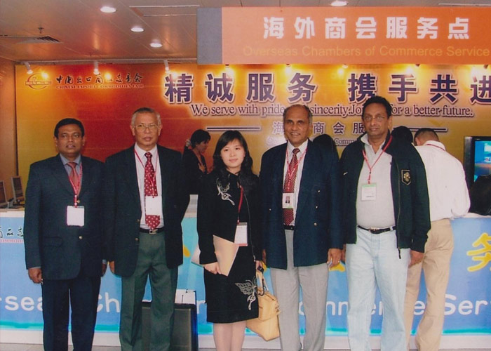
2004
The SLCBCC was incorporated under the Companies Act.
Appointed as the Co-Endorsing party for the China Jiangsu EXPO 2004 held at the BMICH in Colombo.
Organized a 43-member business delegation to visit the 97th Chinese Export Commodities Fair (Canton Fair) at the invitation of the organizers of the Fair.
Held discussions with the Minister Commercial of the Sri Lanka Embassy in China
Held discussions WITH the China Chamber of Commerce & Industry for Import & Export of Machinery & Electronic products.
Met the Vice President of CCPIT Guangdong Sub Council at their Head quarters, and agreed to sign a MOU.
Sent a team of Sri Lankan technicians to China for a Technical training program on Green Tea manufacturing .

Slide 9
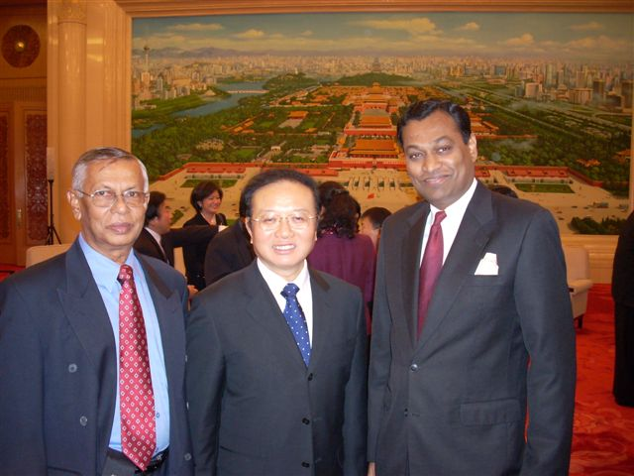
2007
Commemorated the Golden Jubilee of establishing Sri Lanka – China Diplomatic Relations.
Published a full page News paper supplement and initiating the issue of a commemorative Stamp & First day cover.
Participated at the conference on “China – Sri Lanka Relations” co-organized by the Bandaranaike Center for International Studies, Colombo and China Institute of International Studies, Beijing.
Signed a MOU with organizers of the China International Auto parts Expo 2007
Participated at the Friendship Forum organized by the Sri Lanka – China Social & Cultural Cooperation to mark the “Sri Lanka China Year of Friendship”.
A 8 member SLCBCC delegation led by the President visited the 1st China INERNATIONAL AUTO PARTS EXPO .
Participated at the “China- Asia Auto Parts Economic & Trade Seminar & Business Mach Making Meeting” and the President SLCBCC presented a paper on “The Overall Status of Automobile Market in Sri Lanka and Cooperation Opportunities available for Industry”.
The delegation was invited for the banquet hosted by the Ministry of Commerce, P.R. of China at the Great Hall of the People.
Meeting with H.E. the Ambassador for Sri Lanka in China and the Commercial Secretary at the Embassy in Beijing.
Received a Business delegation from CCPIT Sichuan sub Council. Renewed the existing MOU. Hosted the delegation for Diner.
Signed MOU with the China Import & Export Commodities Fair, Kunmin Province.

Slide 10
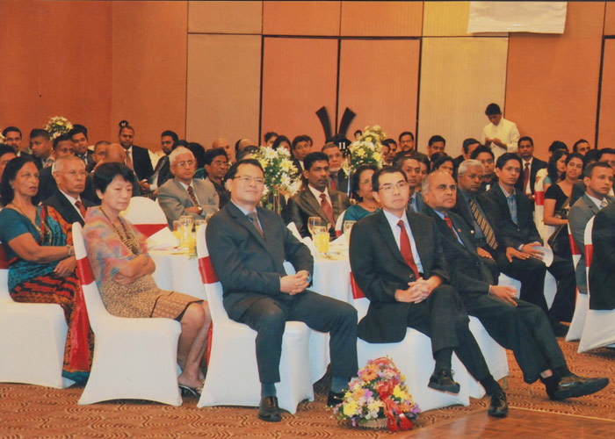
2008
Signed MOU with the CCPIT Jinan Sub Council.
Signed MOU with the CCPIT Hainan Sub Council.
Signed MOU with the CCPIT Guangxi Sub Council.
Re-appointed by the CCPIT Sichuan Sub Council as their sole representative in Sri Lanka for organizing the participation of Sri Lanka Exporters and Manufacturers at the 9th Western China International Economy & Trade Fair held in Sichuan.
Held “Sri Lanka China night “Grand Dinner at the Galadari hotel to commemorate the Golden Jubilee of establishing Sri Lanka – China Diplomatic relations and to felicitate H.E. Ye Dabo, the Ambassador for P.R. of China.

Slide 11
Our KEY functions

Slide 12
A- Promotion & development of ties between Sri lankan & Chinese businessmen b- Liaison with trade related Institutions in P.R. of China securing Govt. assistance towards expanding Trade & Investment ties with China c- Promoting local participation in Trade Fairs held in China specially by the organization and dispatch groups of Businessmen D- To Provide trade and investment inquiries and disseminate economic data and such information amongst the members. E- Maintain an information Desk at The National Chamber of Commerce of Sri Lanka exclusively to serve the interest of members and visiting Chinese businessmen. F- Provision of technical training to employees of local industrialist at Organizations in China g-Providing opportunities to members, on information on market trends of Sri Lankan products in China. H- Co-operation and collaboration with other trade promotional bodies in pursuit of the goal of expanding ties with China I- Improving capacity and ability of members to conduct business with their Chinese counterparts J- Mediate with respective Authorities in China in conflicts between Sri Lanka and Chinese Businessmen and Entrepreneurs K- Conducting workshops & Seminars

Slide 13
What we look forward with CCCSl

Slide 14
Support & co –operation for business star awards 2016 mutual business co-operation Sharing of prospective opportunities close mutual interaction

Slide 15
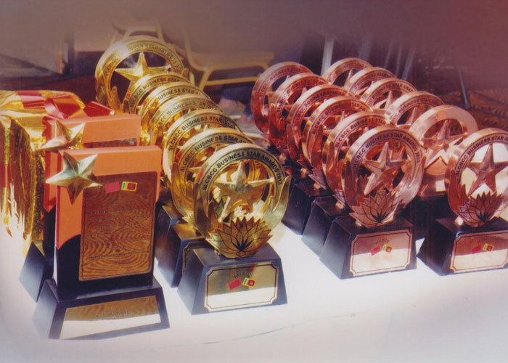
Business star Awards 2011 - 2015

Slide 16
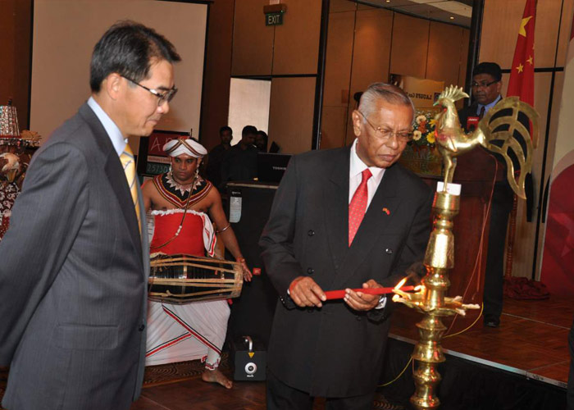
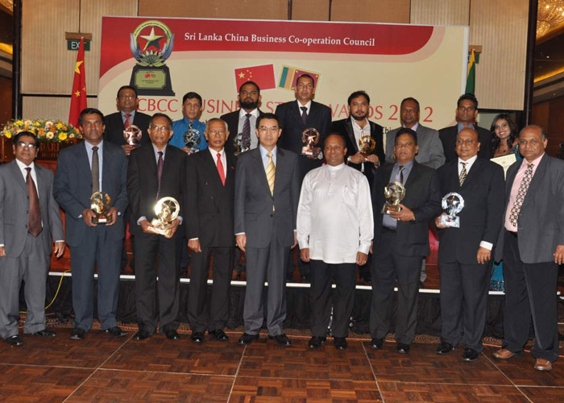
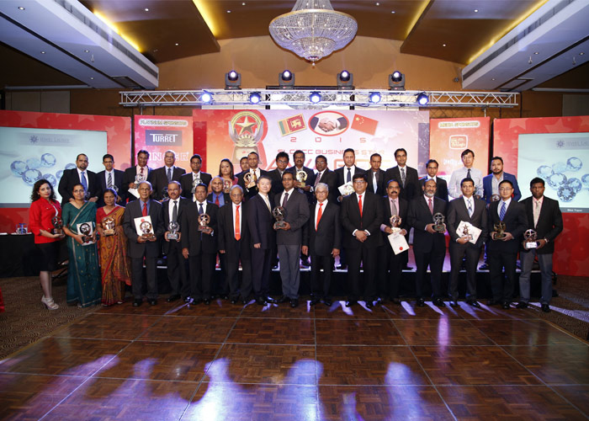
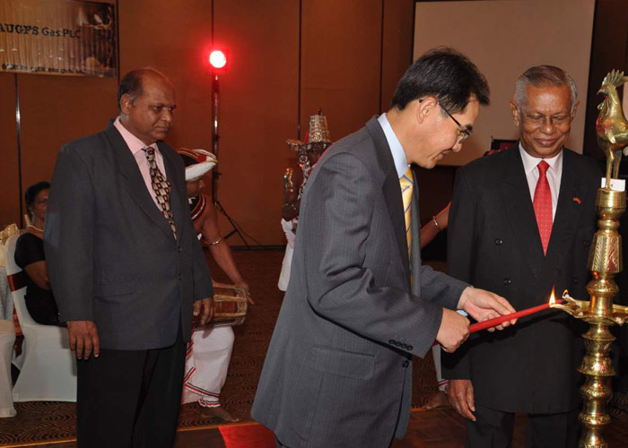
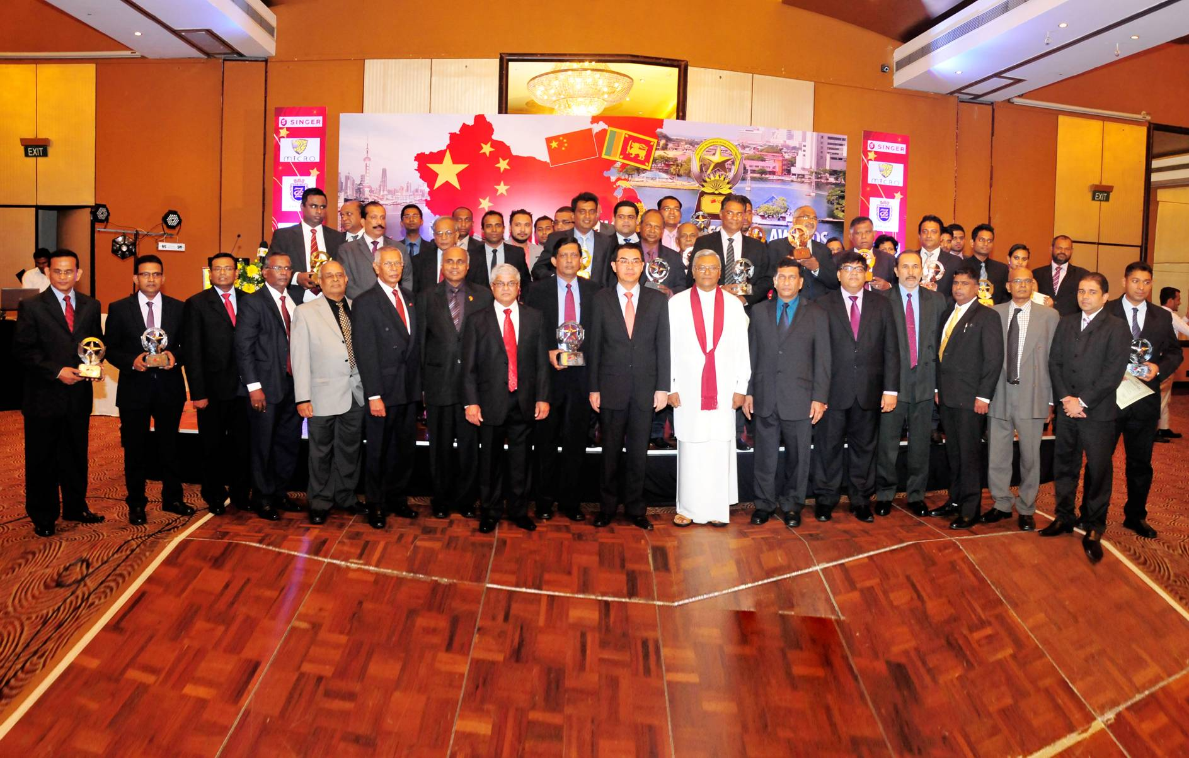
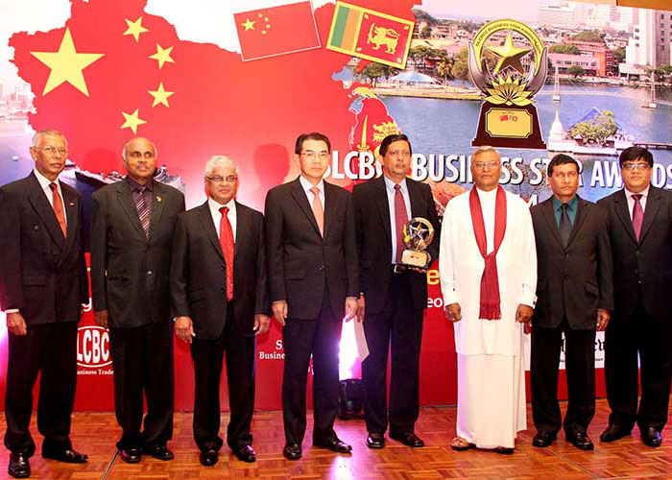
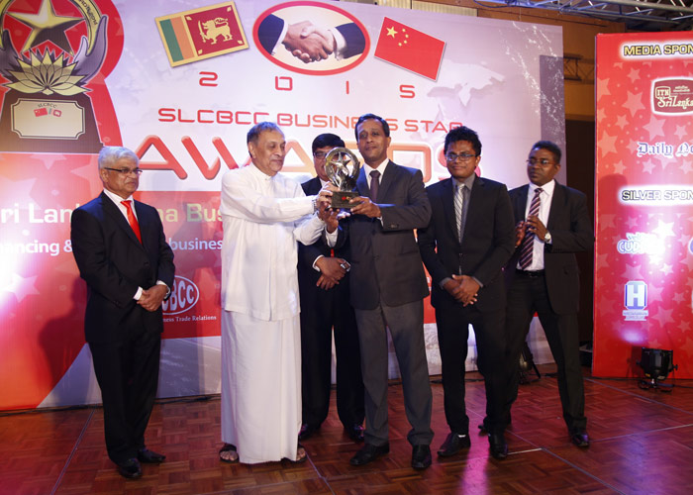

Slide 17
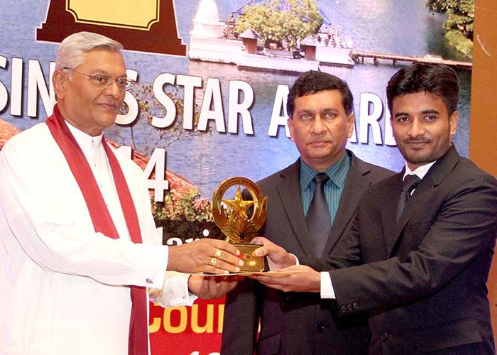
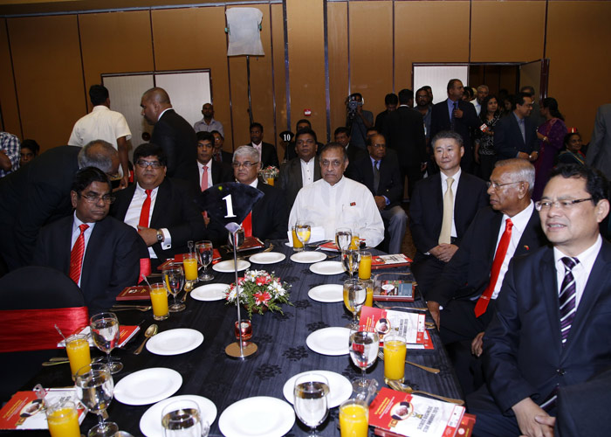
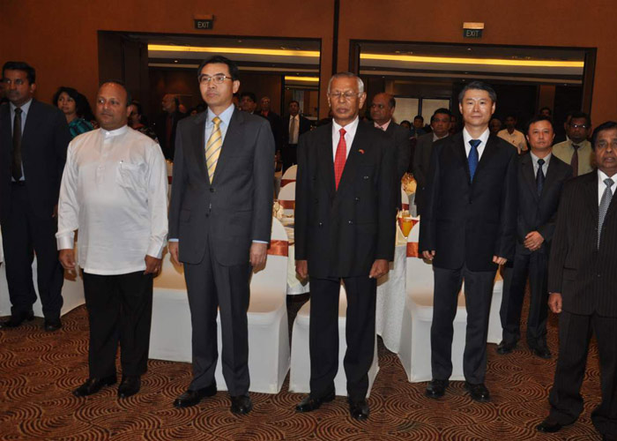
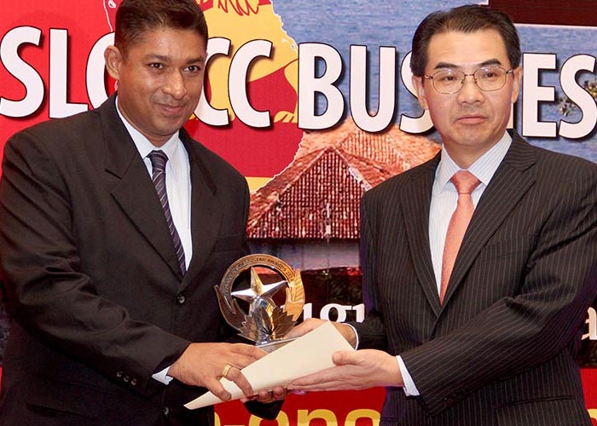
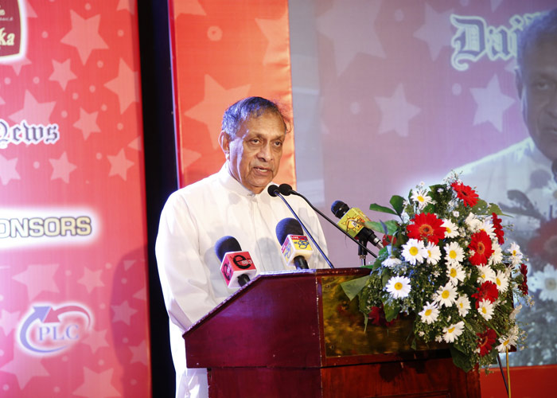
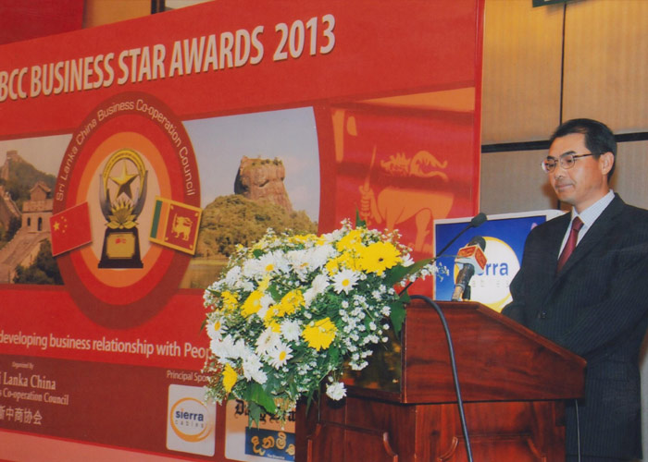
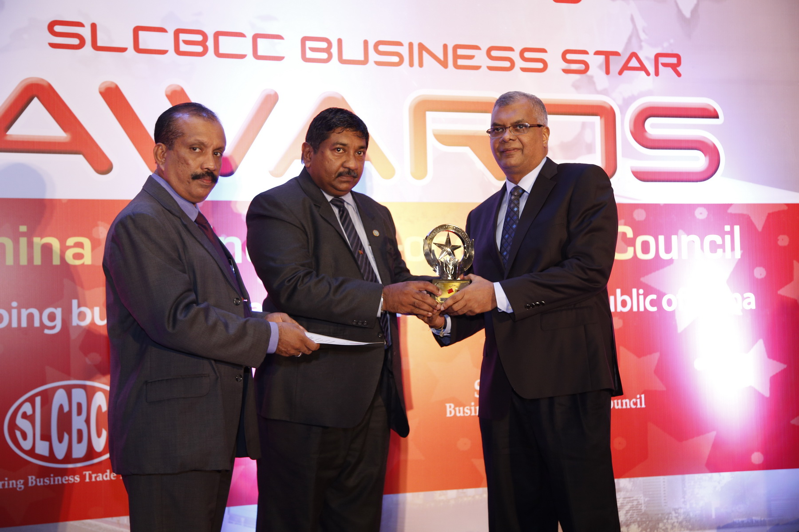

Slide 18
Thank you and enjoy the evening

